Slide 1
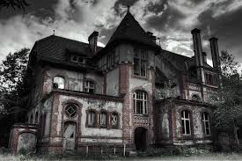
The house on 13th street
The House on Thirteenth Street
By: Caleb M. and Savannah R.
By: Caleb M. and Savannah R.

Slide 2
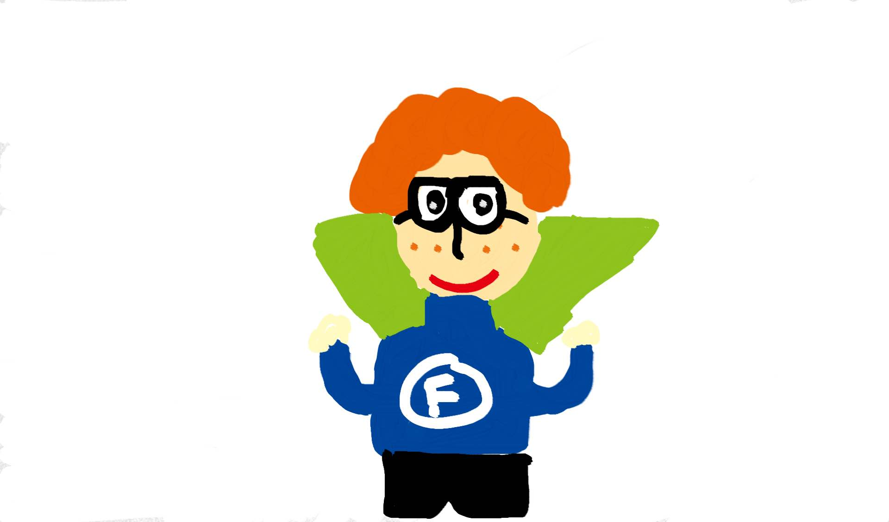
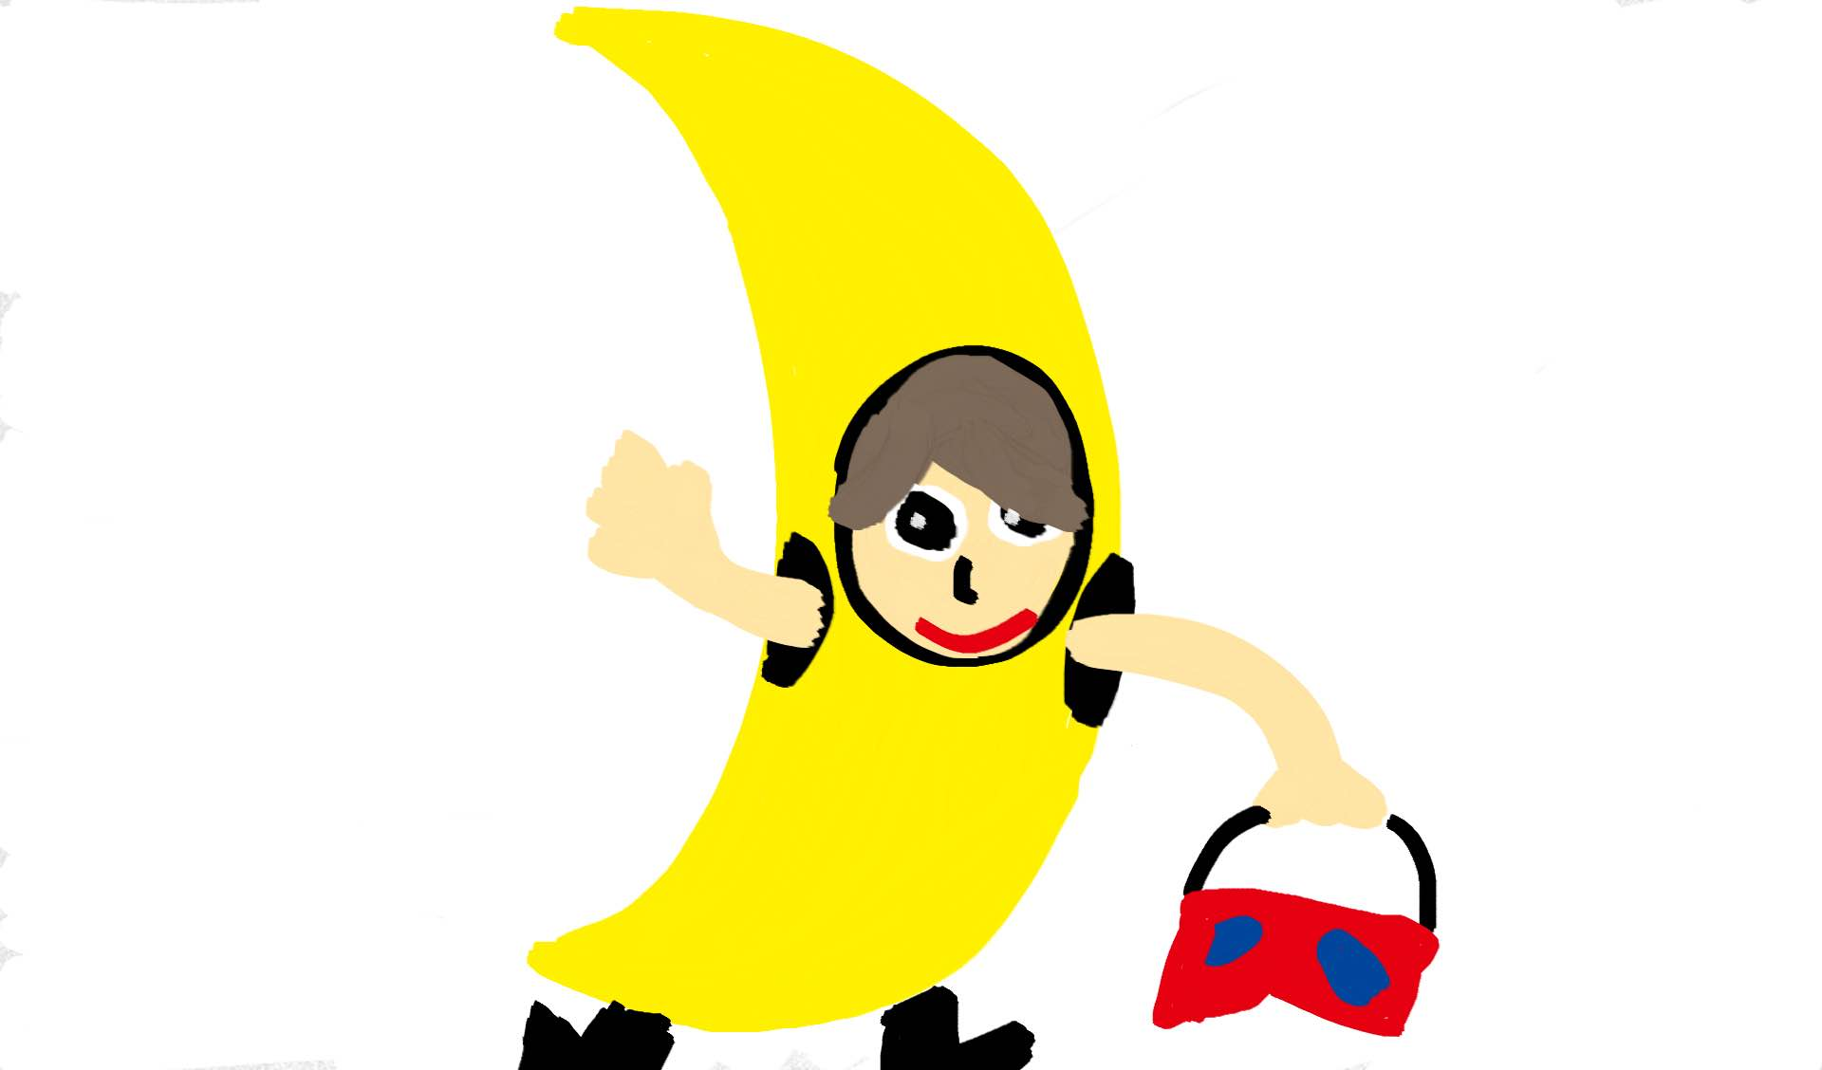
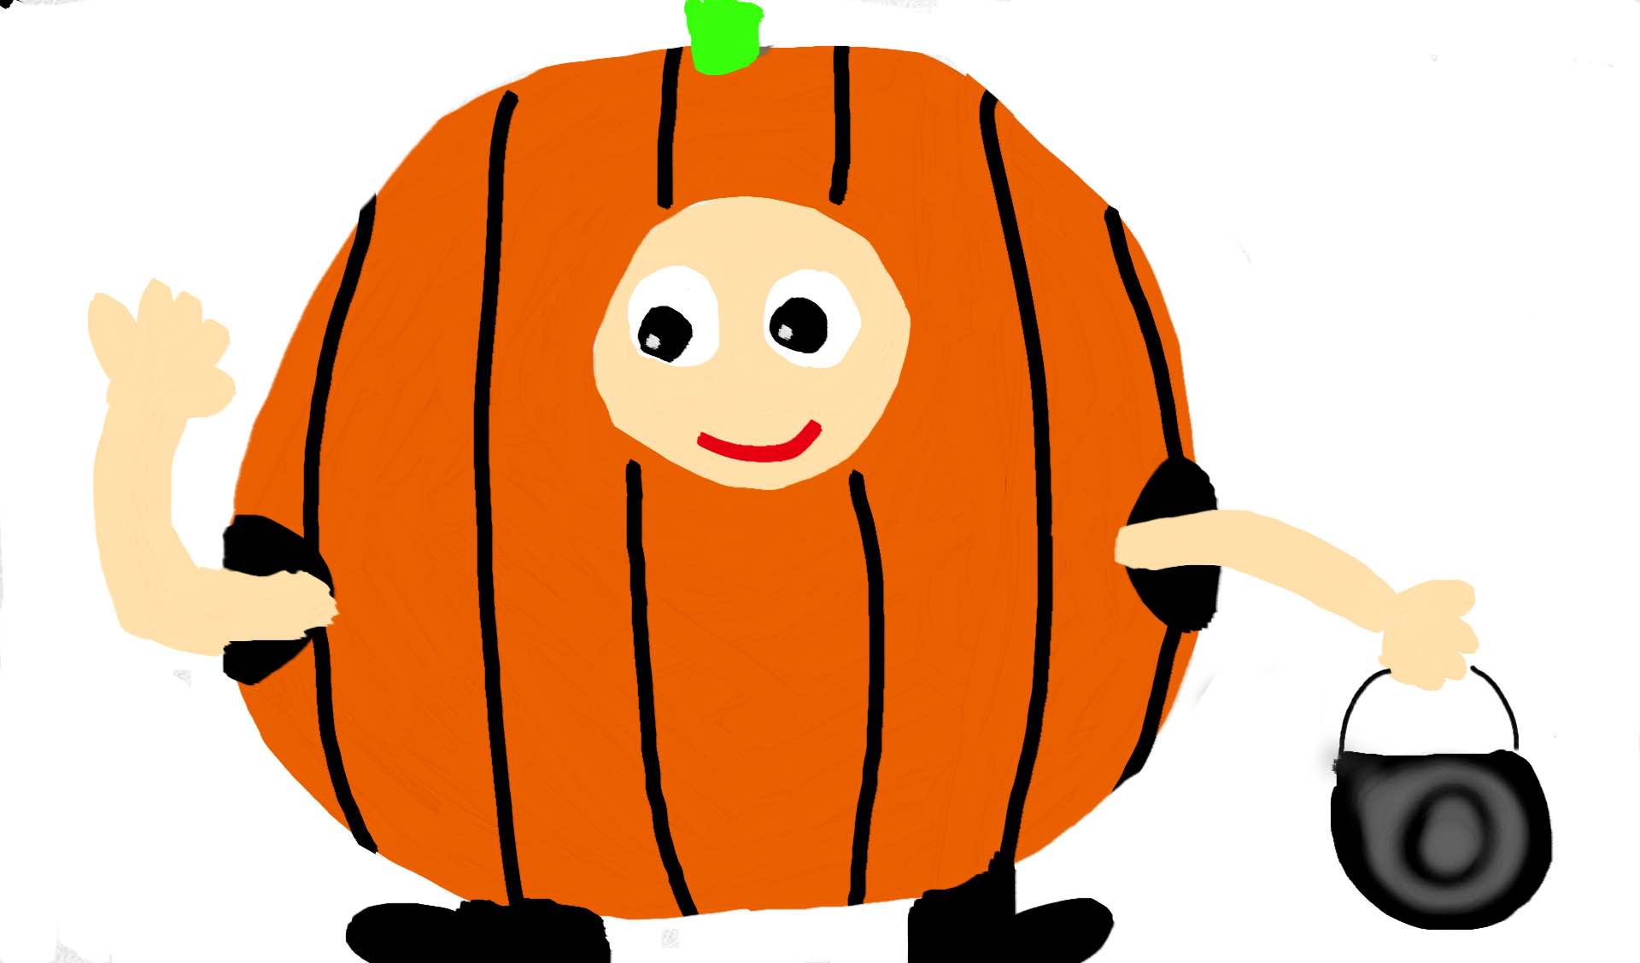
Once there were three kids on a Halloween night. Their names were Frederick, Douglass, and Katelyn. They decided to go trick or treating since they had nothing better to do.

Slide 3
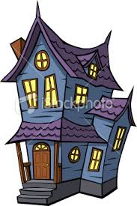
They stumbled upon a haunted and abandoned house. They were not completely sure it was haunted so they wanted to figure it out themselves.

Slide 4
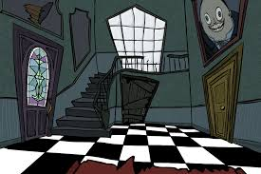
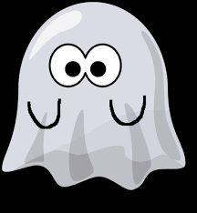
They walked in and saw a ghost on the top of the staircase.But then it dissapeared in thin air. They were so scared they decided to split up. That was a very bad idea….

Slide 5
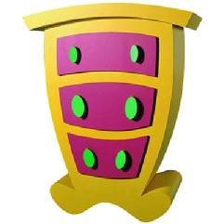
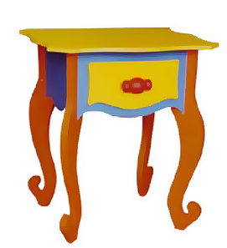
Katelyn got lost in a room and the others were together and Katelyn was alone. Sooner or later Douglass found her and they got back together.

Slide 6
They try to get out of the house as fast as they could, but they reunite with the ghost they saw earlier. It starts chasing them all around the house. They see the front door and run up to it, but need a key.

Slide 7
“Where are we going to get a key?! The ghost is on our tail!” Wait, where is Fredrick?!” Douglass asked. They see Frederick running down the hall with a key in his hand.”Super Frederick to the rescue! Let's get out of here!

Slide 8
They went home with no candy and did not ever speak of that day again.
THE END

Slide 9
Facts/did you know?
•haunted houses are ruled by spirits
. •parapsychologist attribute haunting to the spirits of the dead
•currently in united States there are over 1,200 haunted houses
•ghosts can't harm humans because they are just energy that can't touch you

Slide 10
•Spirits become more active at night, possibly due to a reduced electronic disturbance from appliances and other devices, which compete with or drown out ghostly apparitions. For this reason, you’re more likely to detect ghostly disturbances when your house is quiet • Spirits can manifest in various ways, including orbs, streaks of light, dark shadows, mists and strange blurs. Full-body apparitions are possible, but highly unlikely. • Children and animals are more likely to “see” a ghost. Some children perceive ghosts as imaginary friends. •If a candle flame burns blue or suddenly goes out with no apparent draft or breeze, it’s a sure sign that ghosts are present.
• Spirits can often be helpful, and even protective of the families they “haunt.” • Albert Einstein himself may have postulated a scientific basis for the existence of ghosts. Since energy cannot be created or destroyed but only change its form, what becomes of our energy when we die? Could it be somehow manifested as a ghost? • Albert Einstein wasn’t the first. The concept of ghosts as a form of life after death goes all the way back to ancient Egypt, where people believed that death was merely a transition from one form of existence to another. • The White House is haunted by a number of ghosts, including that of Abigail Adams, who has reportedly been seen hurrying toward the East Room, where she used to hang her laundry. • During Woodrow Wilson’s presidency, the incoming first lady ordered the gardeners to dig up Dolley Madison’s prized Rose Garden. It’s said that Dolley’s spirit turned up and put such a fear of ghosts into the workmen that they fled without turning a single spade. The garden has continued to bloom for nearly two centuries.

Slide 11
Bibliography
•http://www.cuttingedgehauntedhouse.com/blog/haunted-house-news/10-fun-facts-around-ghosts-spirits/

